Slide 1
VEHICAL MANAGEMENT SYSTEM IN C PROGRAM

Slide 2
Abstract
The Vehicle Parking Management System is a lightweight software application developed in C, designed to streamline and automate the management of vehicle parking in small to medium-sized parking facilities. This system addresses common challenges such as inefficient allocation of parking spaces, manual tracking of vehicle details, and time-consuming vehicle removal processes. The program provides key functionalities, including registering vehicles with a unique slot assignment, removing vehicles from the parking lot with automatic reorganization of available slots, and displaying a complete list of parked vehicles for quick reference.

Slide 3
By utilizing structured data storage and efficient algorithms, the system ensures the optimal utilization of parking spaces, reduces errors associated with manual processes, and offers a user-friendly interface for administrators. This solution is ideal for shopping malls, residential complexes, and small businesses seeking a cost-effective method to manage parking spaces without requiring sophisticated hardware or infrastructure. The modular design allows for easy scalability and potential integration with advanced features, such as search functionality or persistent data storage.

Slide 4
Problems and Solutions
Manual Tracking of Parked Vehicles
Problem: Manually recording vehicle details (like vehicle number, type, and parking slot) can lead to errors and inefficiency
Solution: The system automates the process by maintaining a structured record of vehicles in the parking lot.
Efficient Space Utilization
Problem: Inefficient allocation of parking slots can lead to confusion and underutilized parking spaces.
Solution: The program assigns the next available parking slot systematically, ensuring no slot is wasted.

Slide 5
Vehicle Removal and Slot Reorganization
Problem: Removing vehicles and keeping track of the updated parking layout manually can be cumbersome.
Solution: The system handles vehicle removal and dynamically reorganizes slots to maintain efficiency.
Quick Access to Parking Information
Problem: Manually searching for a vehicle or slot information is time-consuming.
Solution: The system allows users to quickly view all parked vehicles, their slot numbers, and types in a tabular format.
Scalability for Small to Medium Parking Lots
Problem: Smaller parking lots often lack affordable systems for managing parking.
Solution: This lightweight system is suitable for small to medium-sized lots, providing an affordable and easy-to-use solution.

Slide 6
Use Cases
Shopping Malls and Offices: To track vehicles in parking spaces and avoid conflicts or mismanagement.
Residential Communities: For managing allocated parking slots for residents and visitors.
Small Businesses: To organize parking for employees and customers. By organizing parking effectively, this system reduces the chances of slot misuse, saves time, and improves user satisfaction in parking lot operations.

Slide 7
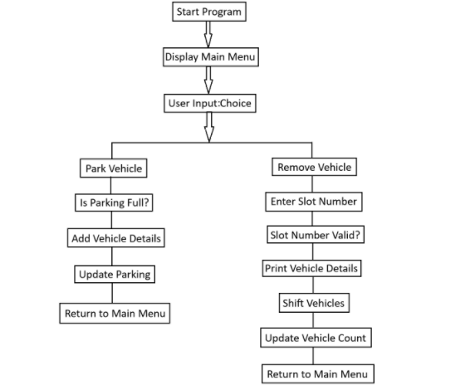
Flow Chart:

Slide 8
Code
#include <stdio.h>
#include <string.h>
#define MAX_PARKING_SPOTS 50
// Structure to store vehicle details
typedef struct
{
int slotNumber;
char vehicleNumber[20];
char vehicleType[20];
} Vehicle;

Slide 9
// Global parking array and parking count
Vehicle parking[MAX_PARKING_SPOTS];
int vehicleCount = 0;
// Function to add a vehicle to the parking
void addVehicle()
{
if (vehicleCount >= MAX_PARKING_SPOTS)
{ printf("Parking is full!\n");
return;
}
Vehicle newVehicle;
newVehicle.slotNumber = vehicleCount + 1;

Slide 10
printf("Enter vehicle number: ");
scanf("%s", newVehicle.vehicleNumber);
printf("Enter vehicle type (Car/Bike): ");
scanf("%s", newVehicle.vehicleType);
parking[vehicleCount] = newVehicle;
vehicleCount++;
printf("Vehicle parked successfully at slot %d.\n", newVehicle.slotNumber);
}
// Function to remove a vehicle from the parking
void removeVehicle()
{
int slotNumber;
printf("Enter the slot number to remove the vehicle: ");
scanf("%d", &slotNumber);

Slide 11
if (slotNumber < 1 || slotNumber > vehicleCount)
{
printf("Invalid slot number!\n");
return;
}
printf("Vehicle with number %s removed from slot %d.\n", parking[slotNumber - 1].vehicleNumber, slotNumber);
// Shift the remaining vehicles
for (int i = slotNumber - 1; i < vehicleCount - 1; i++)
{
parking[i] = parking[i + 1];
}
vehicleCount--;
}

Slide 12
// Function to display the parked vehicles
void displayVehicles()
{
if (vehicleCount == 0)
{ printf("No vehicles parked.\n");
return;
}
printf("Slot No.\tVehicle Number\tVehicle Type\n");
printf("-------------------------------------------------\n");
for (int i = 0; i < vehicleCount; i++)
{
printf("%d\t\t%s\t\t%s\n", parking[i].slotNumber, parking[i].vehicleNumber, parking[i].vehicleType);
}
}

Slide 13
// Main function to run the parking management system
int main()
{
Int choice;
do
{
printf("\n--- Vehicle Parking Management System ---\n");
printf("1. Park Vehicle\n");
printf("2. Remove Vehicle\n");
printf("3. Display Parked Vehicles\n");
printf("4. Exit\n");
printf("Enter your choice: ");
scanf("%d", &choice);

Slide 14
switch (choice)
{
case 1:
addVehicle();
break;
case 2:
removeVehicle();
break;
case 3:
displayVehicles();
break;
case 4:
printf("Exiting the program. Goodbye!\n");
break;

Slide 15
default:
printf("Invalid choice! Please try again.\n");
}
}
while (choice != 4);
return 0;
}

Slide 16
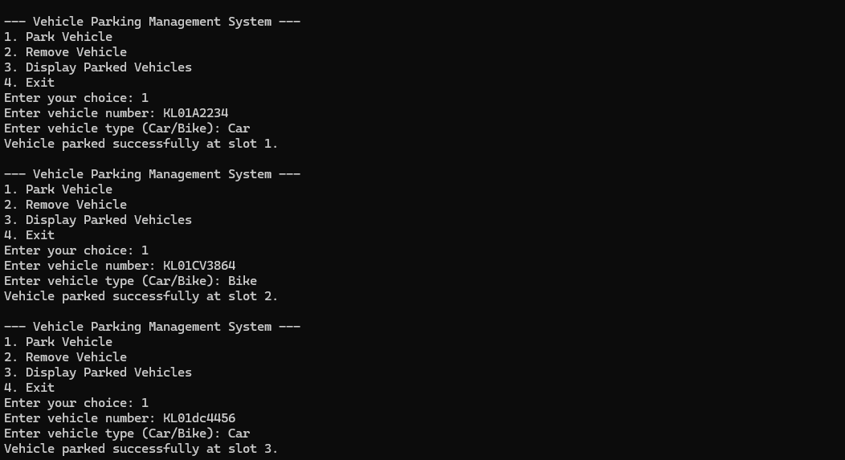
OUTPUT

Slide 17
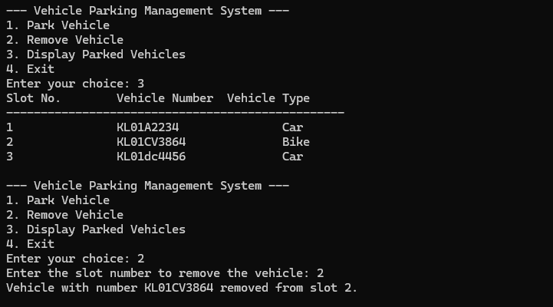

Slide 18
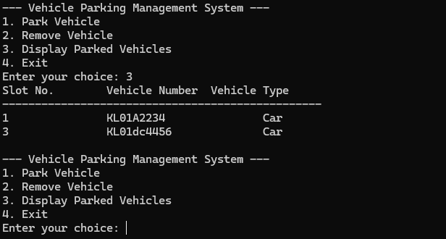

Slide 19
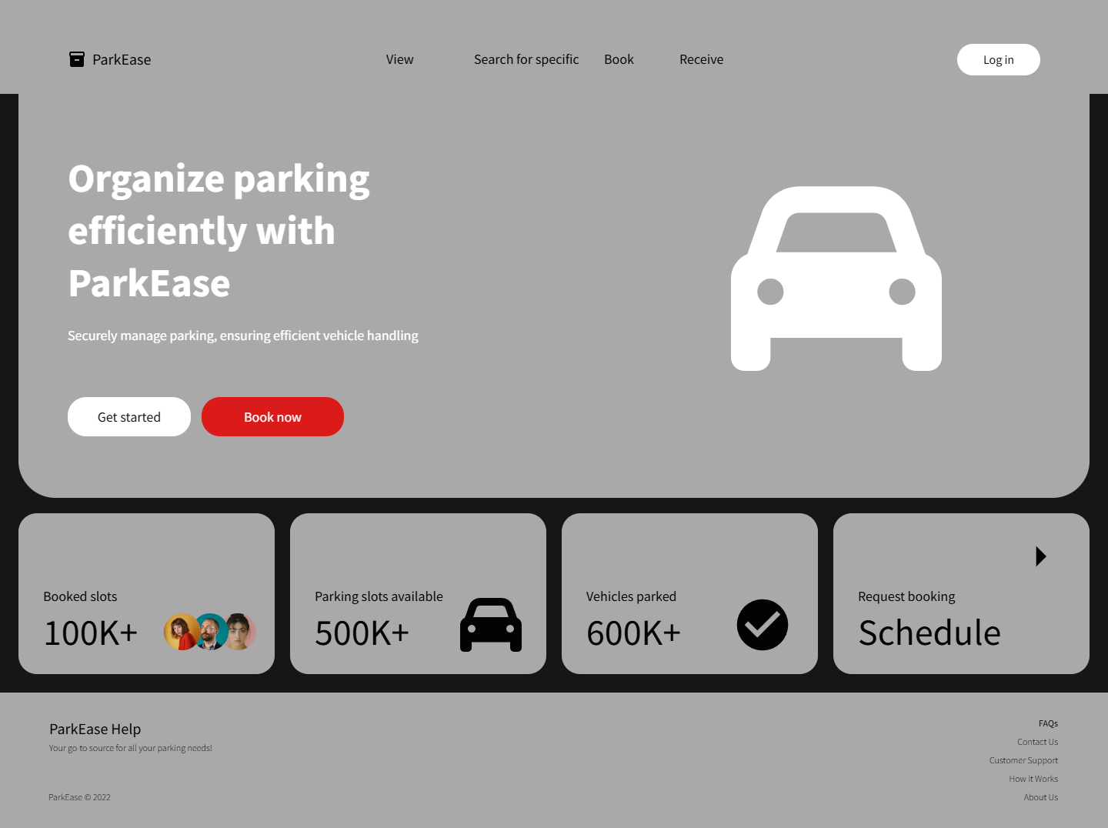

Slide 20
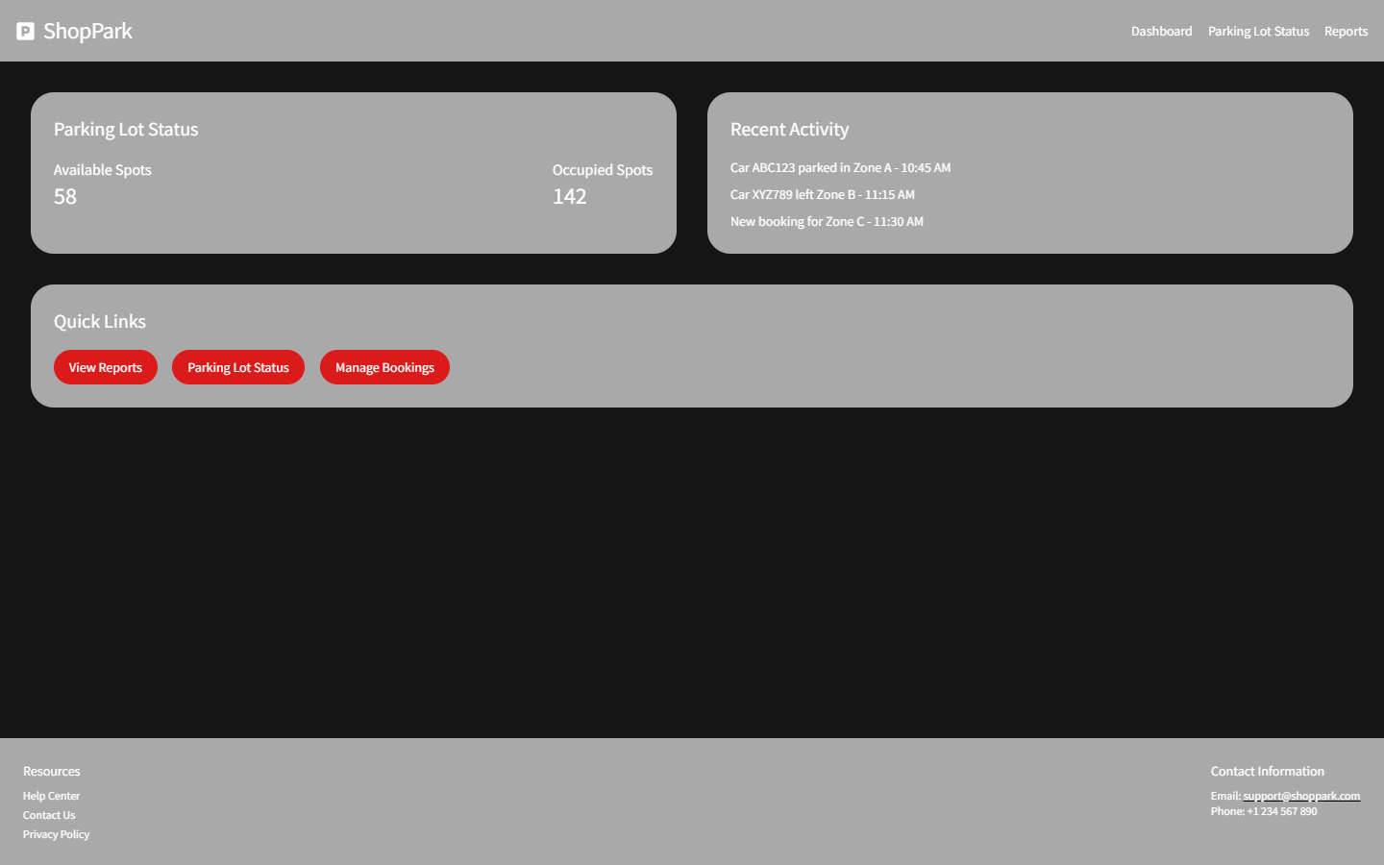

Slide 21
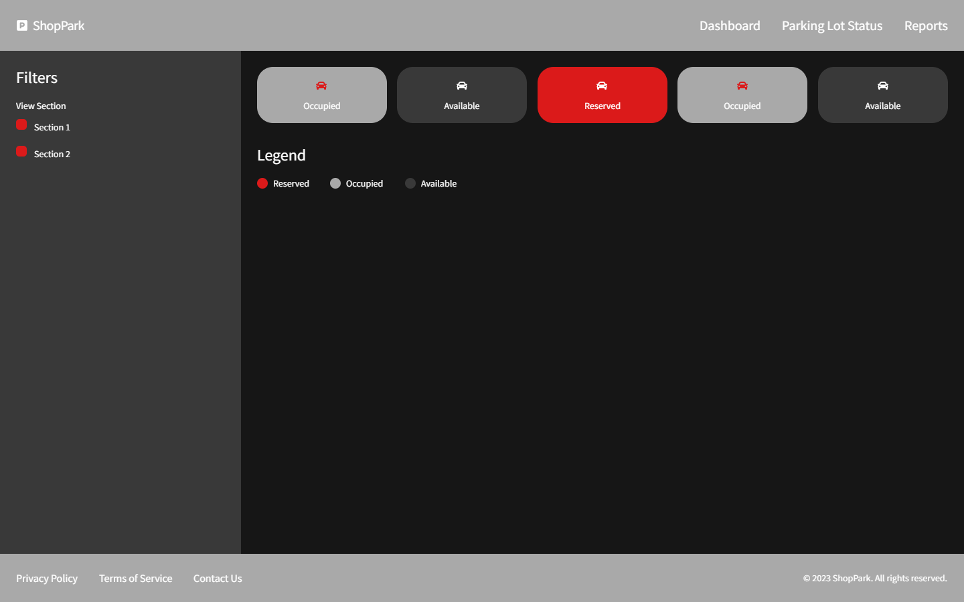

Slide 22
GROUP MEMBERS
Alen Roy Thomas (11)
Adithya Chandra (9)
Avani A Nair (20)
Muthukamal

Slide 23
THANK YOU!

